Slide 1


MSC3182
SOCIAL ENTREPRENEURSHIP
Lesson 8
SALES AND MARKETING

Slide 2
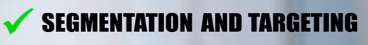





WHY CUSTOMERS WON'T BUY?
In the previous lessons, we have learnt about
CUSTOMER NEEDS
BECAUSE CUSTOMER HAVE AN ALTERNATIVE

Slide 3

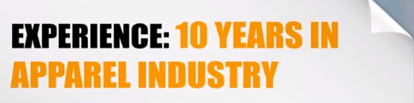



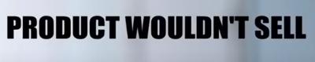
WHY CUSTOMERS WON'T BUY?
LIVE EXAMPLE
Superior in Quality
Product Launched during Prime market season
Easy to Maintain
Cheaper than Similar Products
Offered through all leading retailers
DESPITE HIS PROMOS

Slide 4






WHY CUSTOMERS WON'T BUY?
Why where the customers RELUCTANT to buy the product

Slide 5
WHY CUSTOMERS WON'T BUY?
Many Entrepreneurs BELIEVE that their product have RELATIVE ADVANTAGE over other SIMILAR PRODUCT, that the customer will be WILLING TO SWITCH
This DOESN'T HAPPENS most of the time
Expert Entrepreneurs identified TWO FACTORS for this

Slide 6

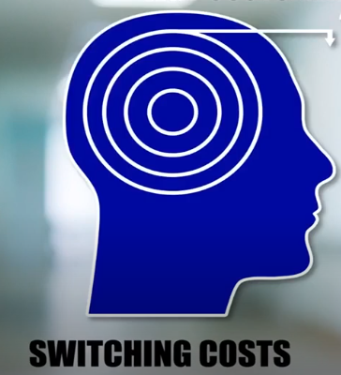
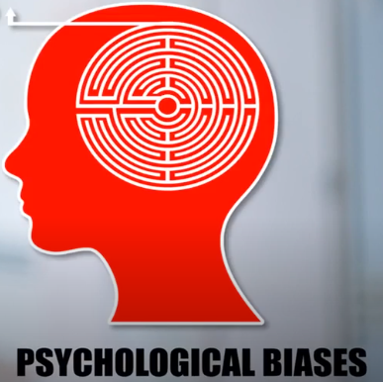
WHY CUSTOMERS WON'T BUY?

Slide 7
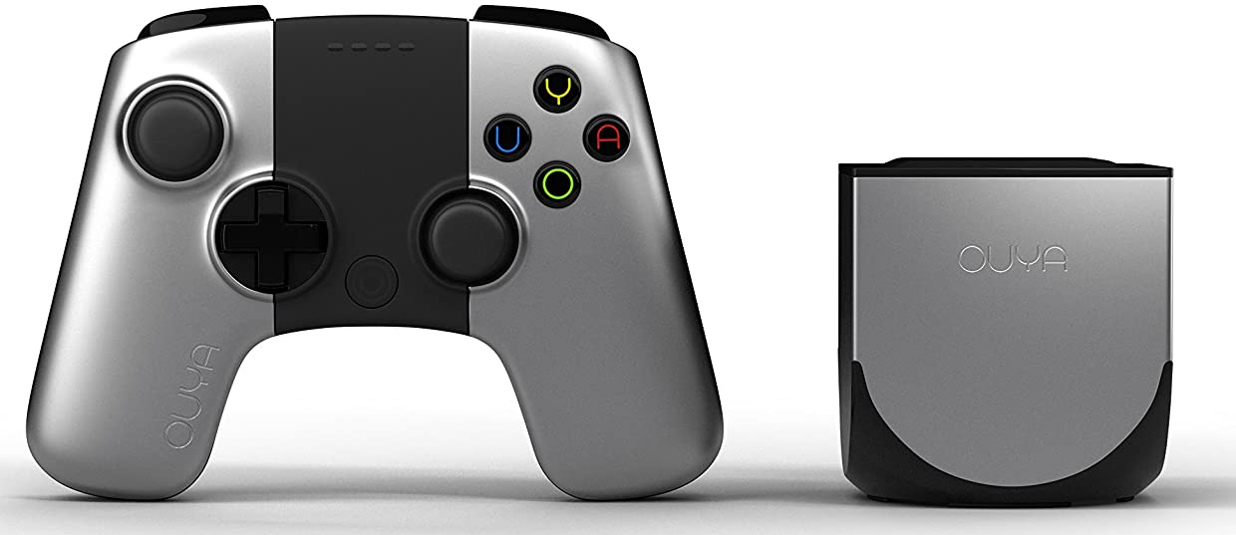

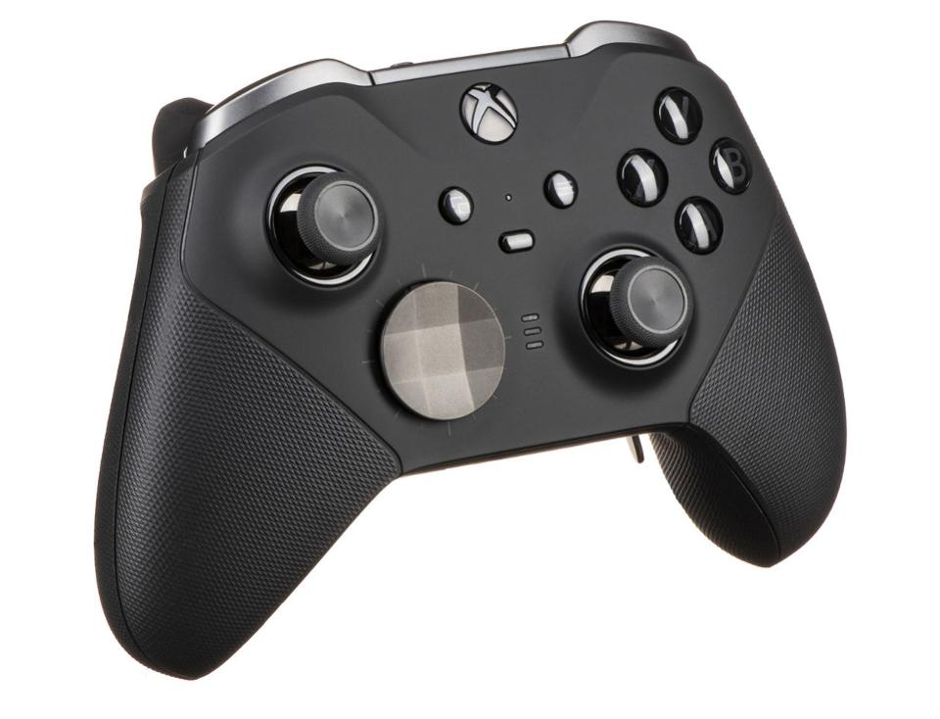
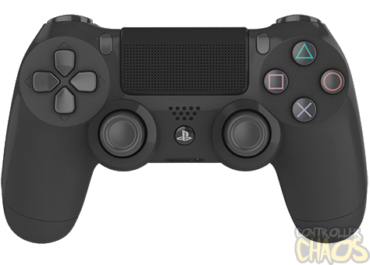


WHY CUSTOMERS WON'T BUY?
SWITCHING COSTS
GAME CONSOLE

Slide 8


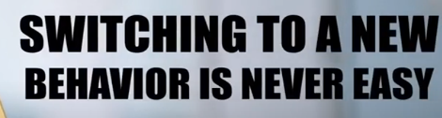
WHY CUSTOMERS WON'T BUY?
SWITCHING COSTS
COMPARATIVELY CHEAPER
FREE VERSON OF ALL GAMES
A BEHAVIOURAL PATTERN HAS SET IN

Slide 9


WHY CUSTOMERS WON'T BUY?
SWITCHING COSTS
VERY COMFORTABLE WITH MS OFFICE
DON’T WANT TO LEARN FEATURES OF NEW SOFTWARE EVEN IT IS BETTER

Slide 10
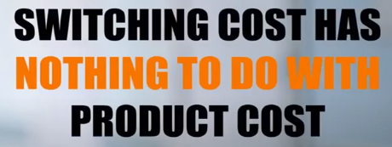
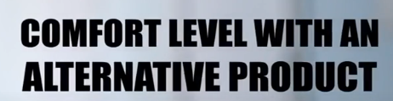
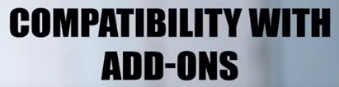
WHY CUSTOMERS WON'T BUY?
SWITCHING COSTS
PLEASE REMEMBER

Slide 11
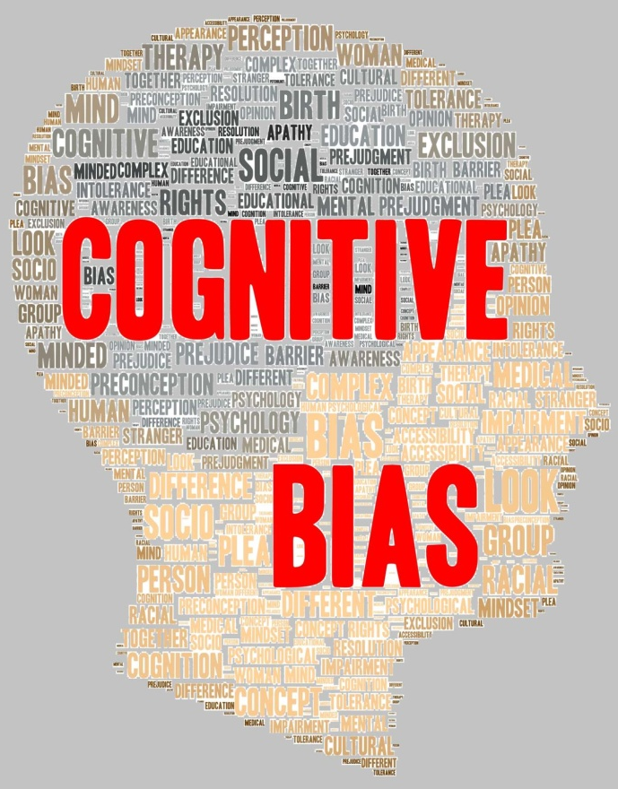

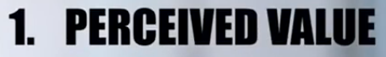
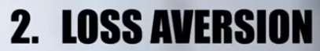

WHY CUSTOMERS WON'T BUY?
PSYCHOLOGICAL BIASES
Is the tendency to make DECISIONS OR TAKE ACTION in an ILLOGICAL WAY.

Slide 12
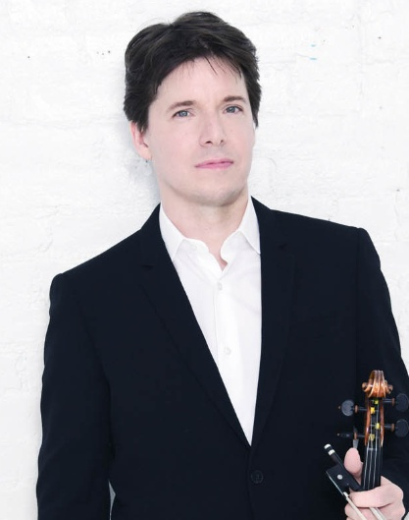
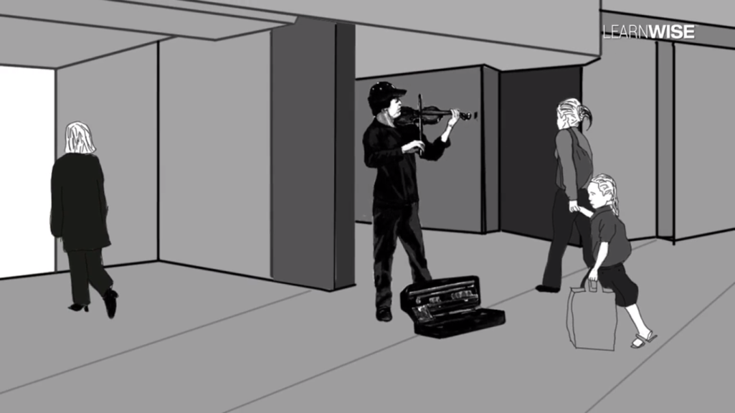
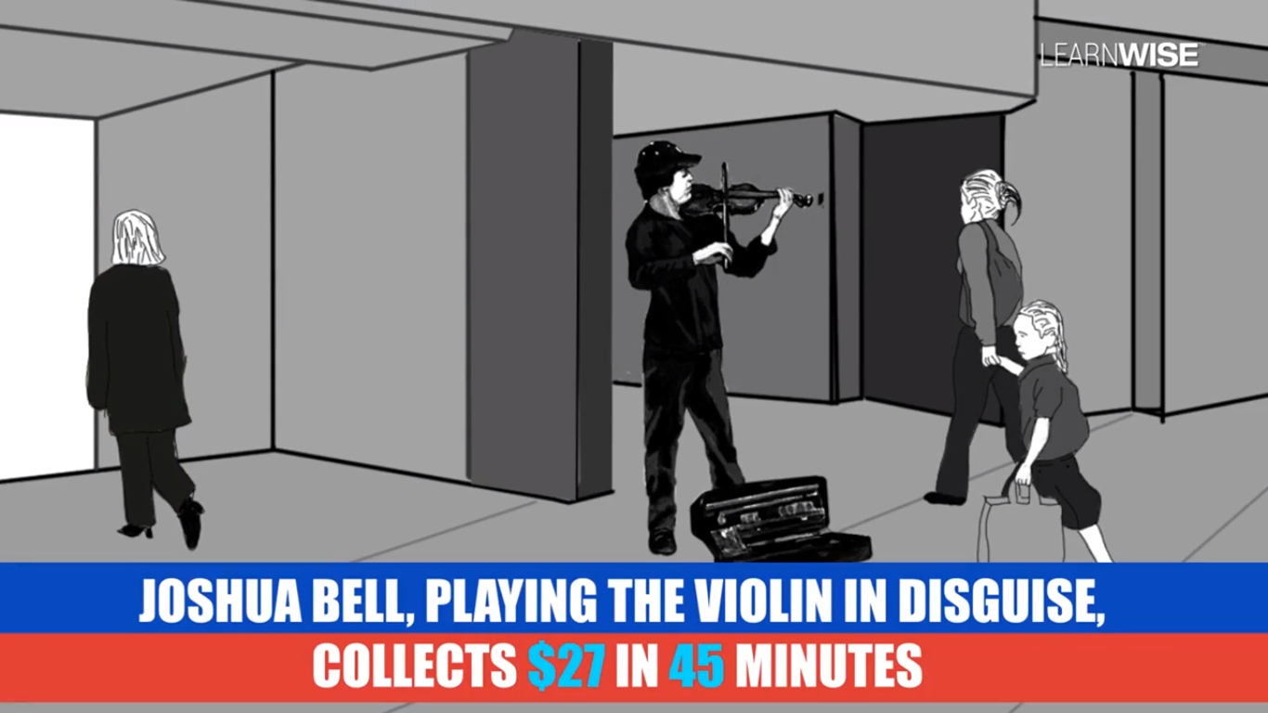
PSYCHOLOGICAL BIASES
PERCEIVED VALUE
Joshua David Bell - one of the MOST CELEBRATED VIOLINISTS of his era.

Slide 13
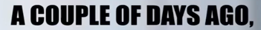









WHY CUSTOMERS WON'T BUY?
PSYCHOLOGICAL BIASES

Slide 14
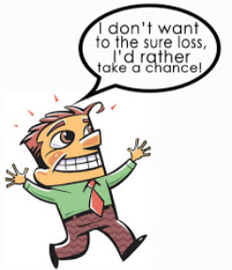




WHY CUSTOMERS WON'T BUY?
LOSS AVERSION
Refers to people's TENDENCY to prefer AVOIDING LOSSES to acquiring EQUIVALENT GAINS
Customer DON’T GIVE UP the already using product for A NEW PRODUCT

Slide 15
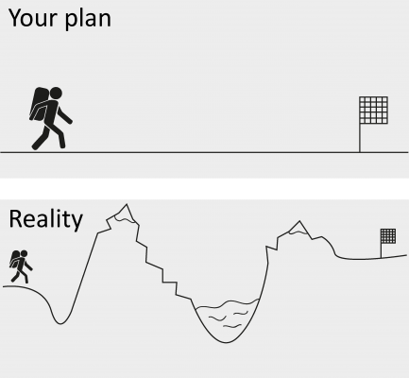
WHY CUSTOMERS WON'T BUY?
OPTIMISM
This bias affects the ENTREPRENEUR – not the CUSTOMER
UNREALISTICALLY OPTIMISTIC about getting favorable results
ENTREPRENEURS fall in to this category as they believe that are OVER ESTIMATE the VALUE of their product

Slide 16
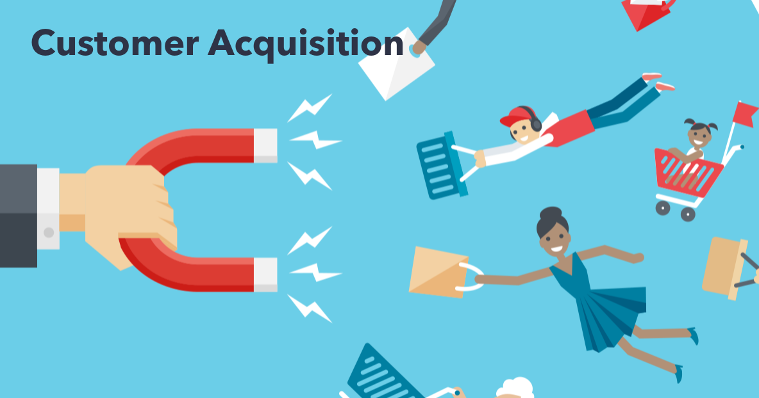
CUSTOMER ACQUISITION

Slide 17



CUSTOMER ACQUISITION
Need to acquire that CUSTOMER
CUSTOMER ACQUISITION is a process
CUSTOMER ACQUISITION is an integral part of the BUSINESS MODEL

Slide 18

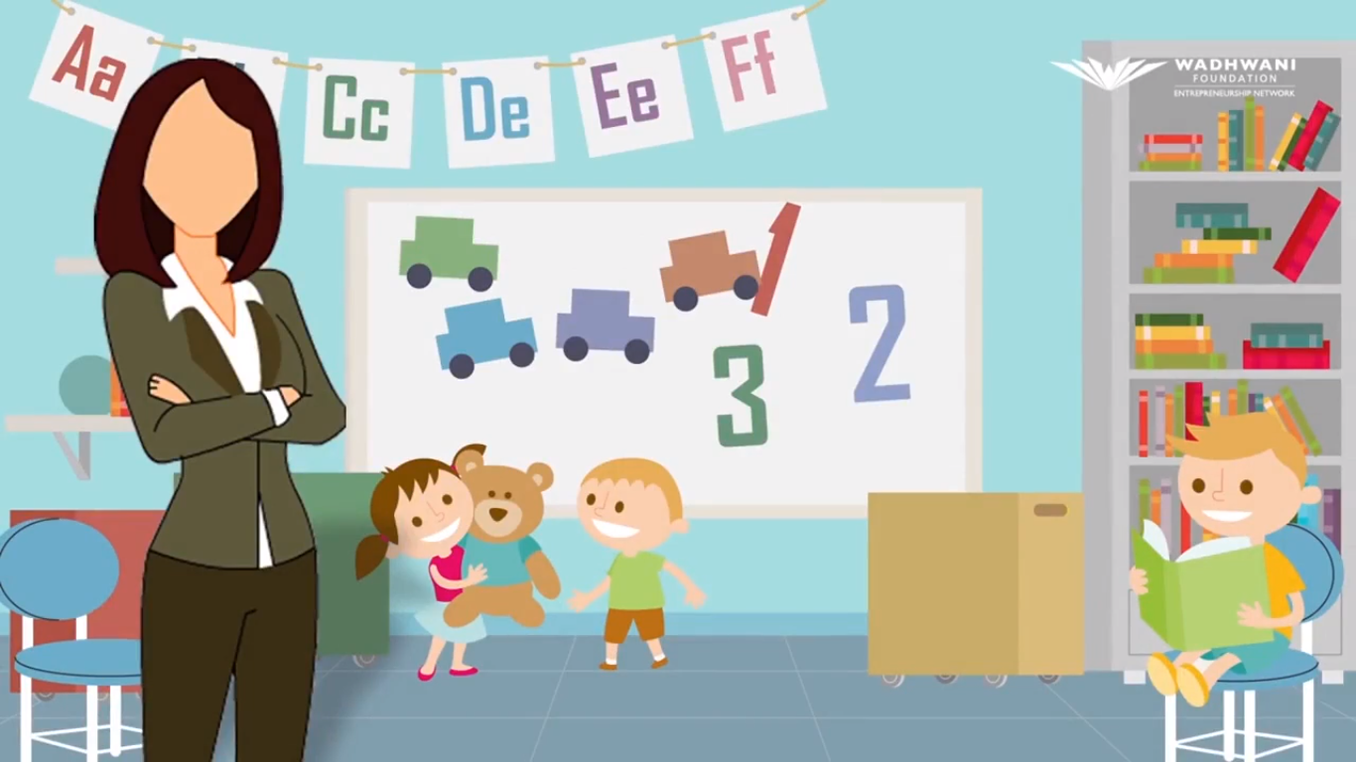
CUSTOMER ACQUISITION
People DROP away at EACH STAGE of the process
Day care service for the WORKING MOTHERS

Slide 19

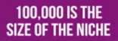
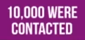
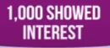
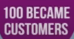
CUSTOMER ACQUISITION
NICHE – WORKING MOTHERS with children in the AGES OF 1 – 4
SOCIAL MEDIA
ENQUIRING ABOUT THE SERVICE

Slide 20
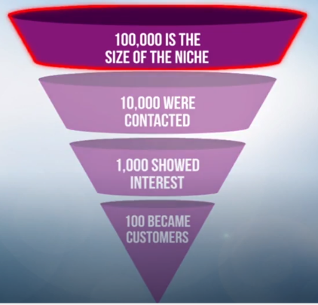
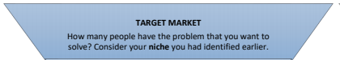
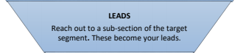
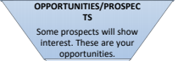
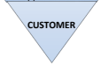
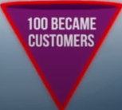
CUSTOMER ACQUISITION

